Slide 1
http://www.chemtube3d.com/solidstate/_table.htm

Slide 2
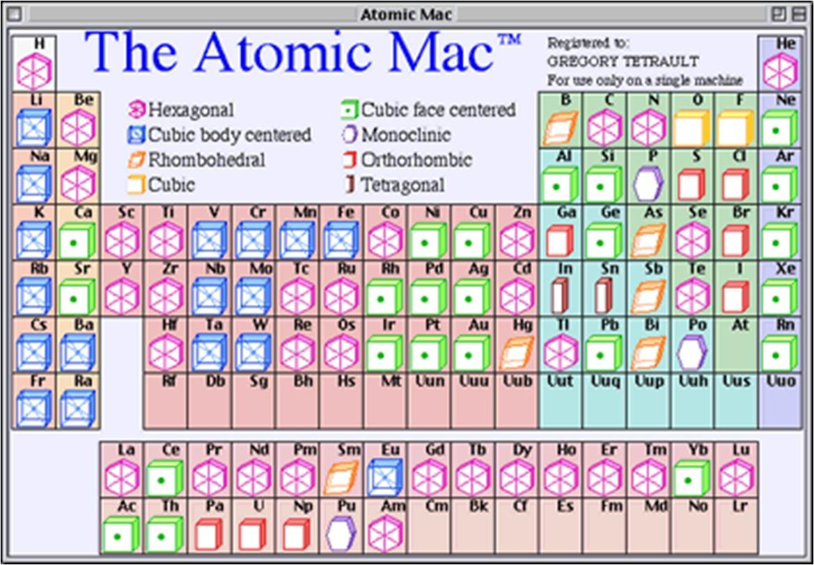

Slide 3
Ceramic Crystal Structures

Slide 4
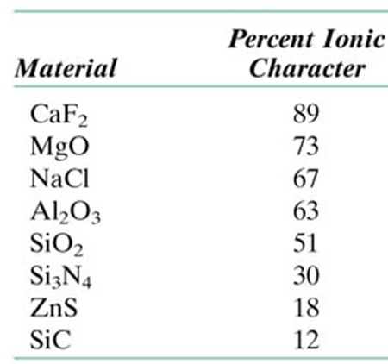
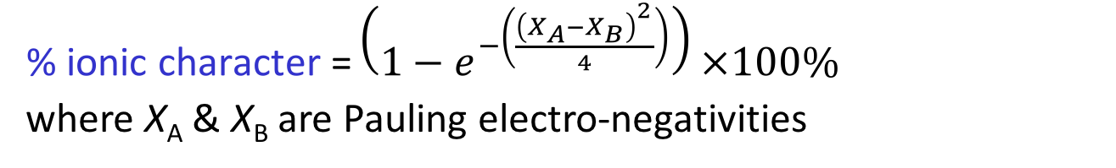
t12_01_pg416
Bond characters of ceramics
$$\text{\% }\text{ionic} \text{character}\text{ =}\left(1−e^{−\left(\frac{{\left(X_{A}−X_{B}\right)}^{2}}{4}\right)}\right)×100\%$$
where X_{A}&X_{B} are Pauling electro-negativities
For ceramic materials with predominantly ionic character, crystal structure is composed of cations and anions
Two characteristics of these ions influence the crystal structure
The magnitude of electrical charge (Charge balance must be there)
Relative sizes (Each cation/ anion prefers to have as many nearest neighbour anions/ cations as possible)
Notes:
t12_01_pg416.jpg

Slide 5
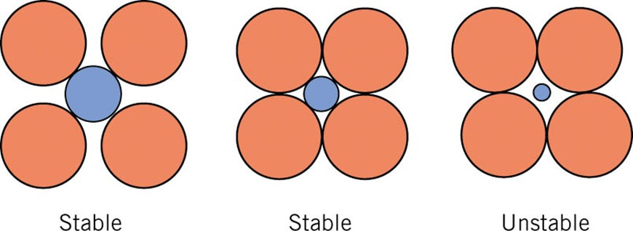
f12_01_pg416
Radius Ratio Rules
Stable ceramic crystal structure forms when those anions surrounding a cation are all in contact with that cation
The coordination number (number of anion nearest neighbours for a cation) is related to the cation anion radius ratio
For a specific coordination number, there is a critical or minimum rC/rA ratio for which this cation-anion contact is established
Notes:
f12_01_pg416.jpg

Slide 6
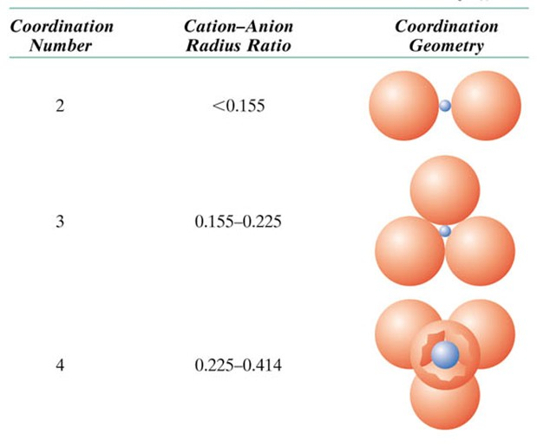

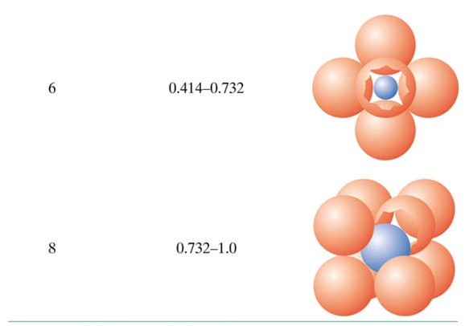
t12_02_pg417
Radius Ratio Rules
Some points about ionic size:
Cation< atom < anion
Cation with higher positive charge are smaller
As coordination number increases, cation size increases
Notes:
t12_02_pg417.jpg

Slide 7
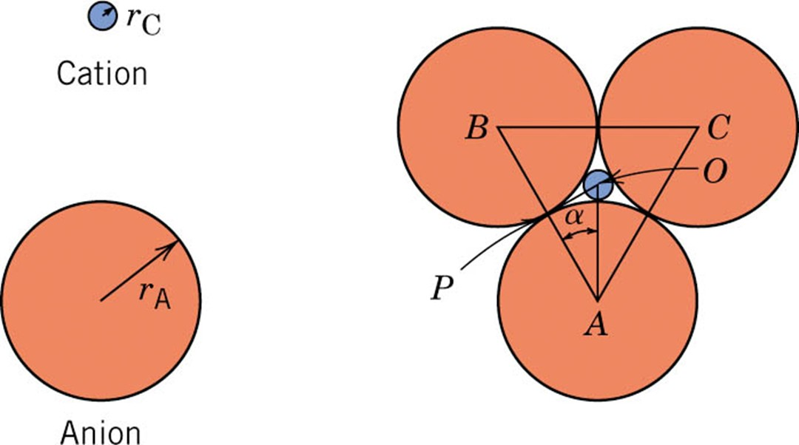
f_pg419
Minimum r_{C}/r_{A} ratio for CN=3
Notes:
f_pg419.jpg

Slide 8
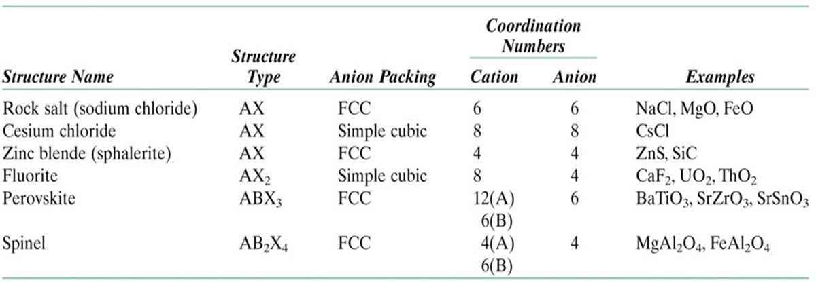
t12_04_pg422
Common Ceramic Crystal Structures
FCC
SC
Notes:
t12_04_pg422.jpg

Slide 9
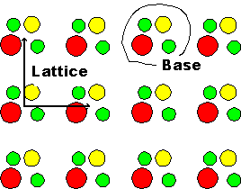
Crystal = Bravais lattice + Base
A crystal is obtained by taking a Bravais lattice and adding a base! The base can just be one atom (as in the case of many elemental crystals, most noteworthy the metals), two identical atoms (e.g. Si, Ge, C(diamond)), two different atoms (NaCl, GaAs, ...) three atoms, ... up to huge complex molecules as in the case of protein crystals.

Slide 10
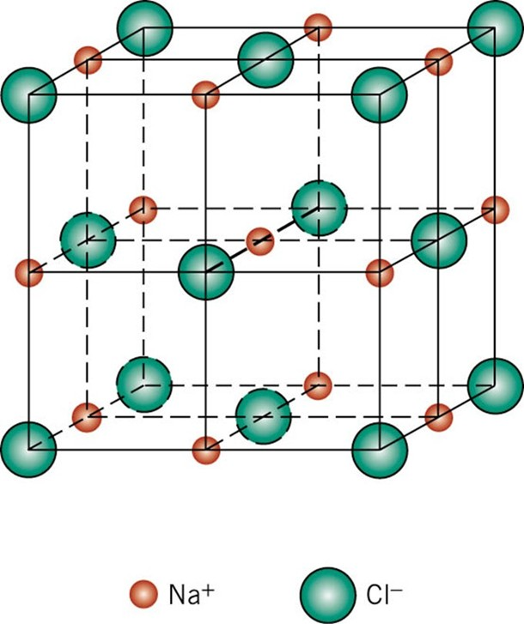
f12_02_pg420
Rock Salt (NaCl) Structure
(fcc), with two atoms in the base: one at (0, 0, 0), the other one at (½, ½, ½)
Many salts and oxides have this structure, e.g. KCl, AgBr, KBr, PbS, ... or MgO, FeO, ...
Notes:
f12_02_pg420.jpg

Slide 11
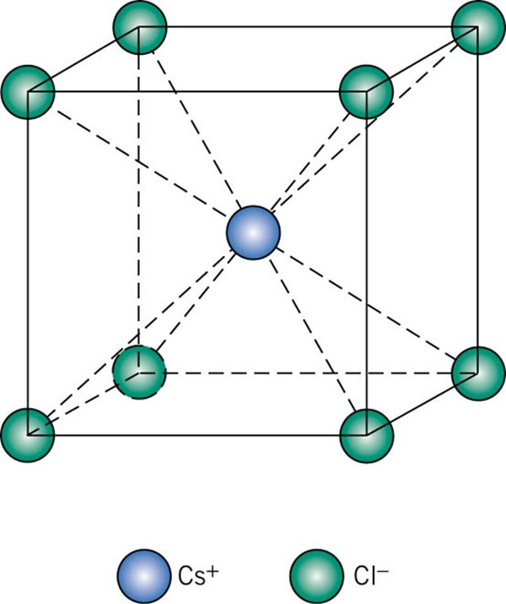
f12_03_pg420
CsCl Crystal Structure
cubic primitive with two atoms in the base at (0,0,0) and (½, ½, ½)
Intermetallic compounds (not necessarily ionic crystals), but also common salts assume this structure; e.g. CsCl, ..., or AlNi, CuZn
Notes:
f12_03_pg420.jpg

Slide 12
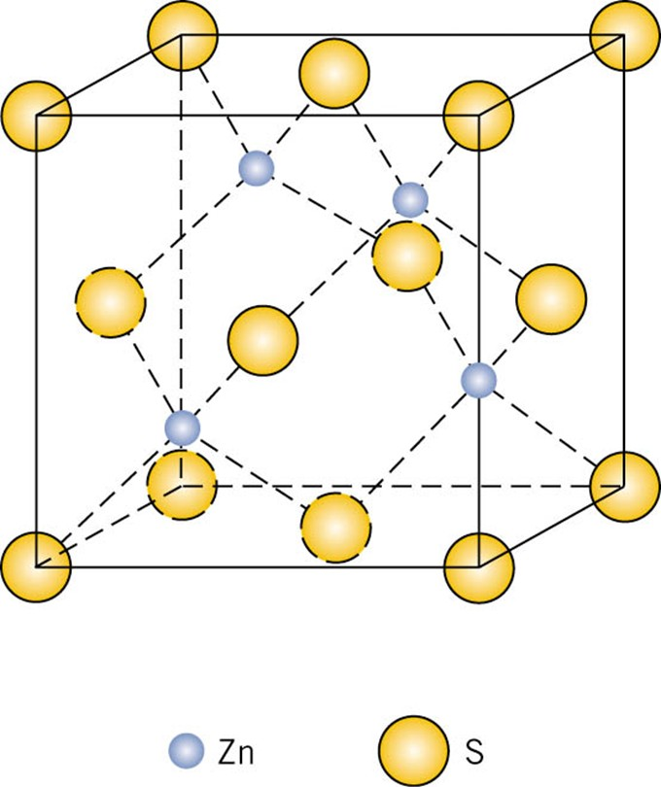
f12_04_pg421
ZnS (Zinc Blende) Structure
(fcc) with two atoms in the base at (0,0,0) and (¼, ¼, ¼)
typical lattice of covalently bonded group IV semiconductors (C (diamond form), Si, Ge) or III-V compounds semiconductors (GaAs, GaP, InSb, InP, ..)
Notes:
f12_04_pg421.jpg

Slide 13
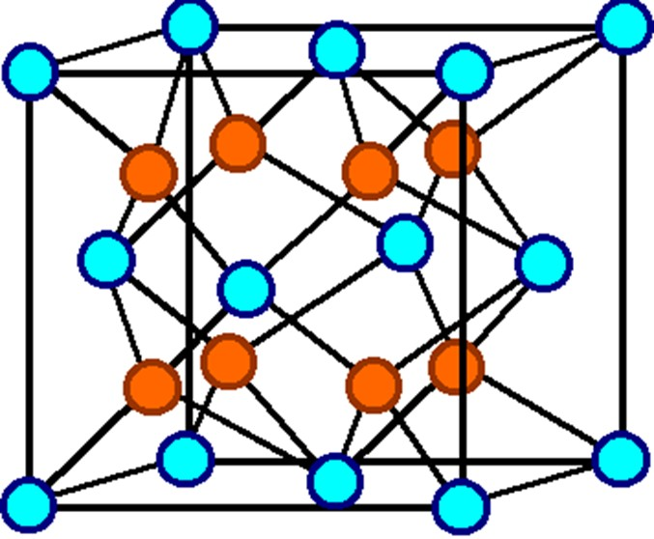
f12_05_pg421
CaF₂ (Fluorite) Structure
(fcc) with three atoms in the base, one kind (the cations) at (0,0,0), and the other two (anions of the same kind) at (¼, ¼, ¼), and (-¼, -¼, -¼)
Notes:
f12_05_pg421.jpg

Slide 14
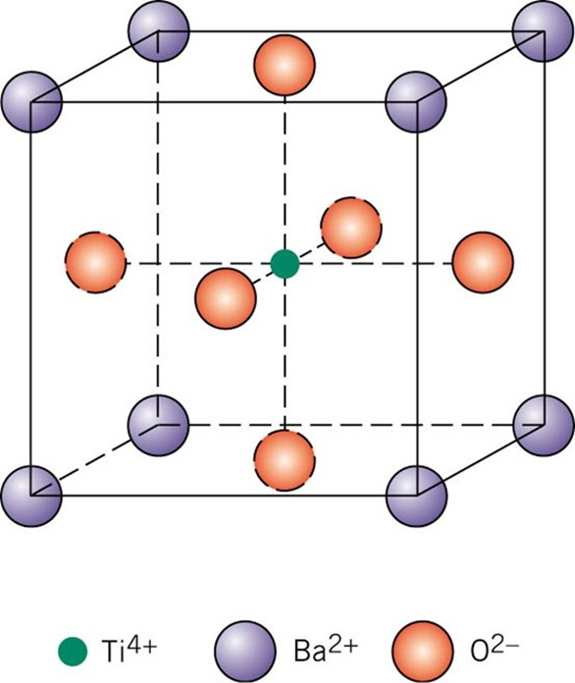
f12_06_pg422
Perovskite crystal Structure
cubic primitive:
three different atoms in the base. In the example it would be Ba at (0,0,0), O at (½, ½, ,0), at (½, 0, ½), at (0, ½, ½) and Ti at (½, ½, ½).
Barium titanate (BaTiO₃), having both Ba²⁺ and Ti⁴⁺ cations
Notes:
f12_06_pg422.jpg

Slide 15

f12_02_pg420
Rock Salt (NaCl) Structure
Notes:
f12_02_pg420.jpg

Slide 16
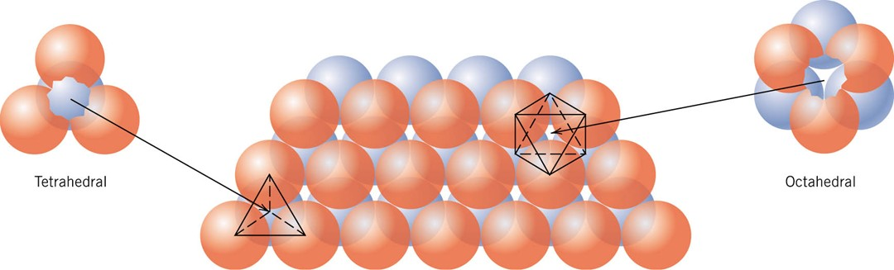
f12_07_pg423
Close Packed Structure in ceramics
Close packed planes of anions
Cations reside at Tetrahedral and/ or Octrahedral interstitial sites
Notes:
f12_07_pg423.jpg

Slide 17
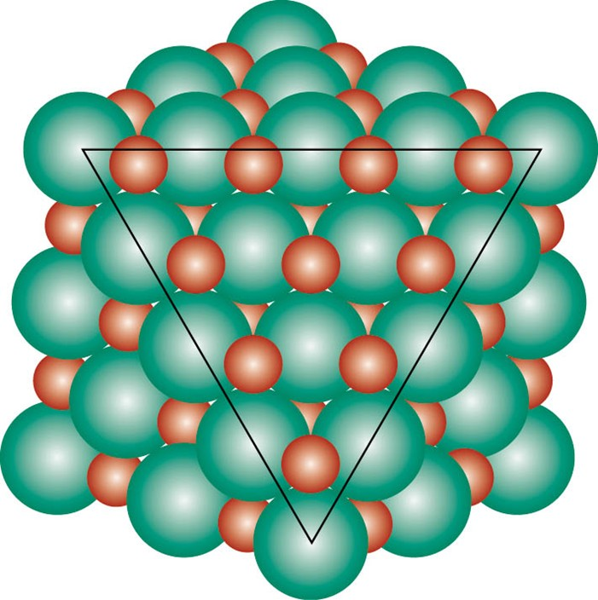
f12_08_pg424
Rock Salt (NaCl) Structure
Close packed arrangement of Cl ions on {111} planes
Na+ ions are at Octahedral sites
Notes:
f12_08_pg424.jpg

Slide 18
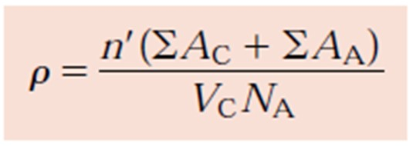
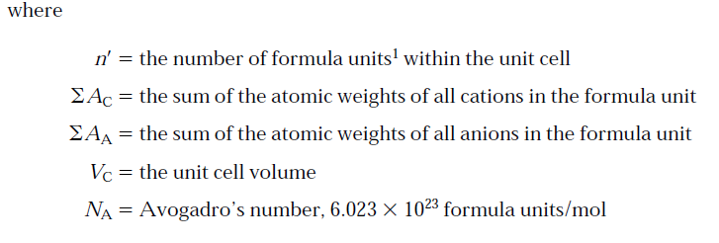
DENSITY COMPUTATIONS—CERAMICS

Slide 19
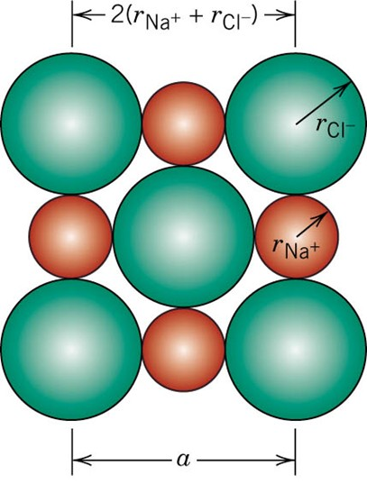


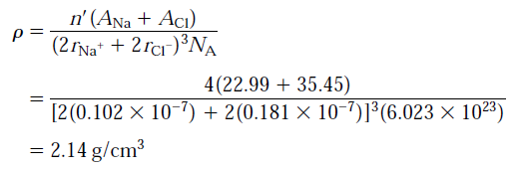
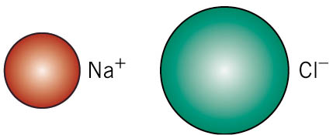
f_pg425
DENSITY COMPUTATIONS—CERAMICS
n’ = 4; FCC lattice
Experimental value: 2.16 gm/cc
Notes:
f_pg425.jpg

Slide 20
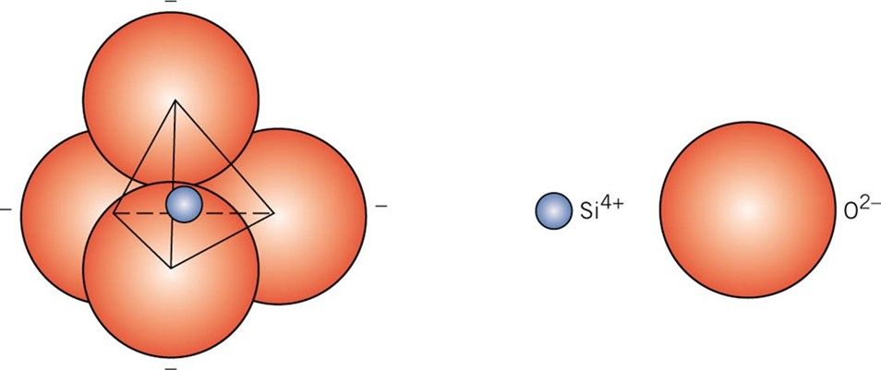
f12_09_pg426
Silicate Ceramics
Soils, rocks, clays, and sand come under the silicate classification
Characterize crystal structure in terms of various arrangements of an SiO₄⁴⁻ tetrahedron
Basic unit of the silicates
Notes:
f12_09_pg426.jpg

Slide 21
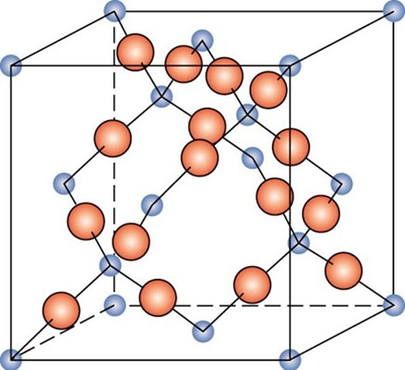
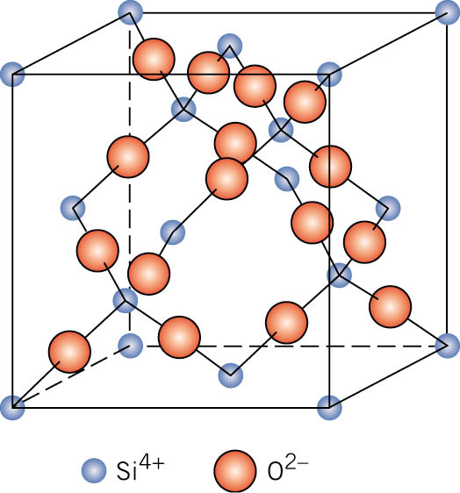
f12_10_pg427
Silica (SiO₂)
Chemically, the most simple silicate
Structurally, it is a 3d network generated when every corner O atom in each tetrahedron is shared by adjacent tetrahedra.
Electrically neutral
The ratio of Si to O atoms is 1 : 2, as indicated by the chemical formula.
Three primary polymorphic crystalline forms of silica: quartz, cristobalite and tridymite.
Strong Si-O bonds → high mp
Relatively open str. → Low density
Notes:
f12_10_pg427.jpg

Slide 22
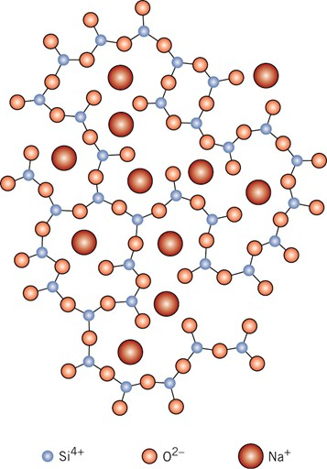
f12_11_pg428
SILICA GLASSES
Silicon dioxide (or silica, SiO₂) in the noncrystalline state is called fused silica, or vitreous silica
Other oxides (e.g., B₂O₃ and GeO₂) may also form glassy structures
Network formers
The common inorganic glasses used for containers → Silica glasses to which have been added other oxides such as CaO and Na₂O
Cations are incorporated within and modify the SiO₄⁴⁻ network
Network modifiers
Lowers the mp and viscosity of glasses → easy formation at low temp
structure of a sodium–silicate glass
Notes:
f12_11_pg428.jpg

Slide 23
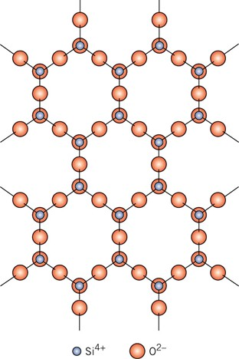
f12_13_pg429
Sheet or layered silicates
A 2d sheet or layered structure
By sharing of 3 O ions in each of the tetrahedra
Repeating unit formula: (Si₂O₅)²⁻
A second planar sheet structure having an excess of cations → Charge neutrality
Their basic structure is characteristic of clays and other minerals
Notes:
f12_13_pg429.jpg

Slide 24
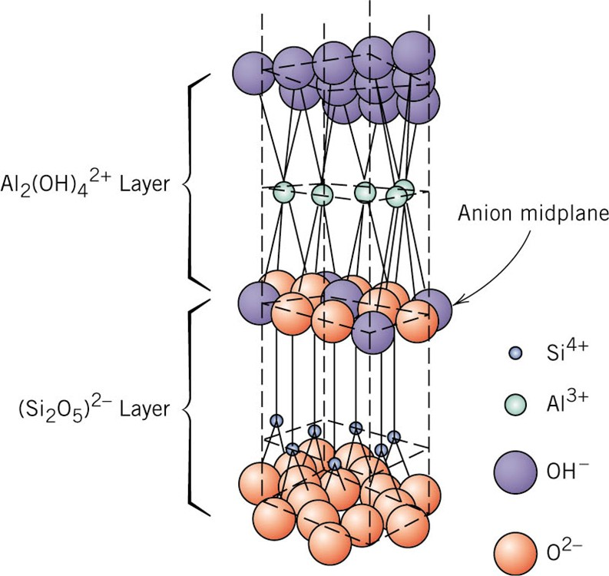
f12_14_pg430
Keolinite (Clay):
2 layer silicate sheet structure
Al₂(Si₂O₅)(OH)₄
Talc
Mica
Notes:
f12_14_pg430.jpg

Slide 25
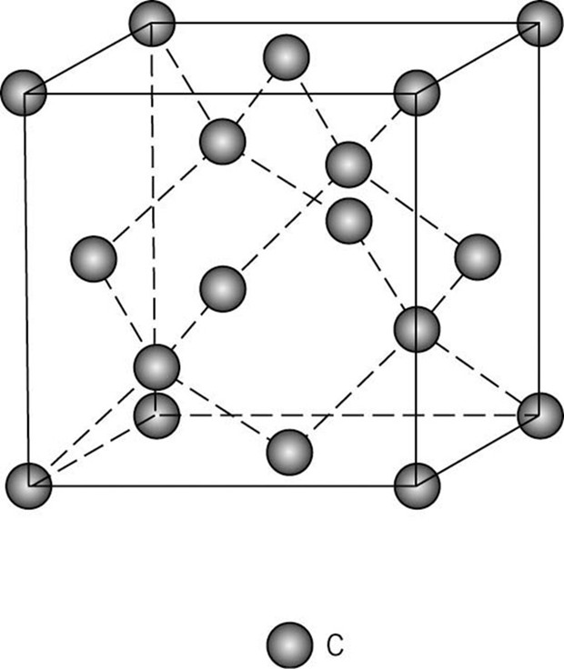
f12_15_pg431
Diamond Cubic Structure
Extremely hard
Low electrical conductivity
Optically Transparent
High index of refraction
Notes:
f12_15_pg431.jpg

Slide 26
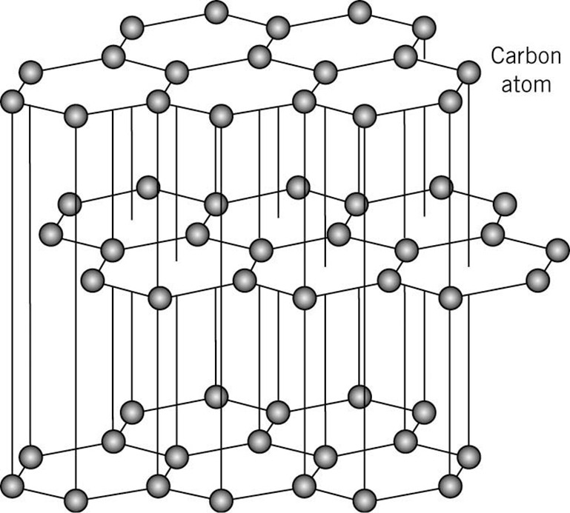
f12_17_pg432
Graphite
Lubricative property
Electrical conductivity along sheet
Notes:
f12_17_pg432.jpg

Slide 27
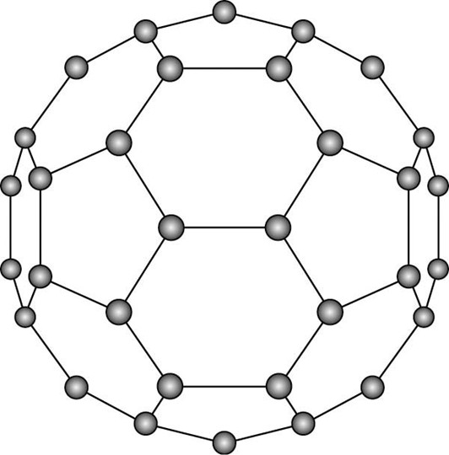
f12_18_pg432
Fullerenes
Exists in molecular form
C₆₀
Each molecule called Buckyball
Material consisting of C₆₀ molecules are called Buckminsterfullerene or Fullerene
Notes:
f12_18_pg432.jpg

Slide 28
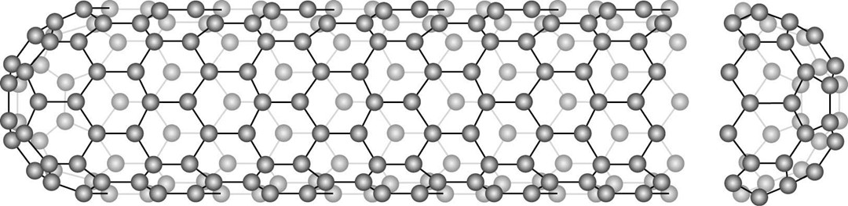
f12_19_pg433
Carbon Nanotube
Single sheet of graphite rolled into a tube. Both ends are C₆₀ hemispheres
Notes:
f12_19_pg433.jpg

Slide 29
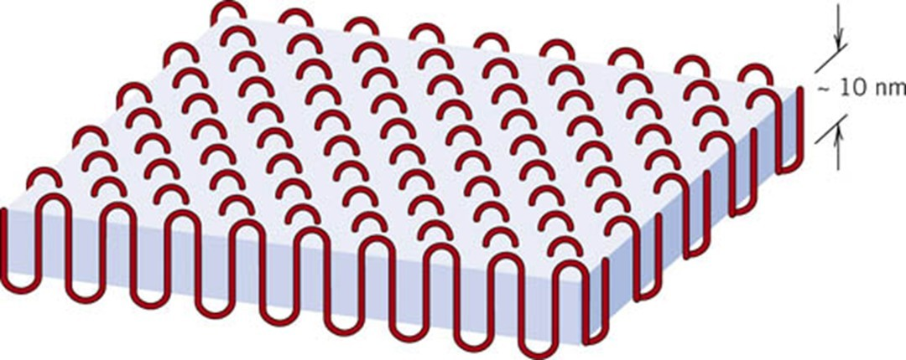
f14_12_pg513
Chain Folded model of Polymer crystallite
Notes:
f14_12_pg513.jpg

Slide 30
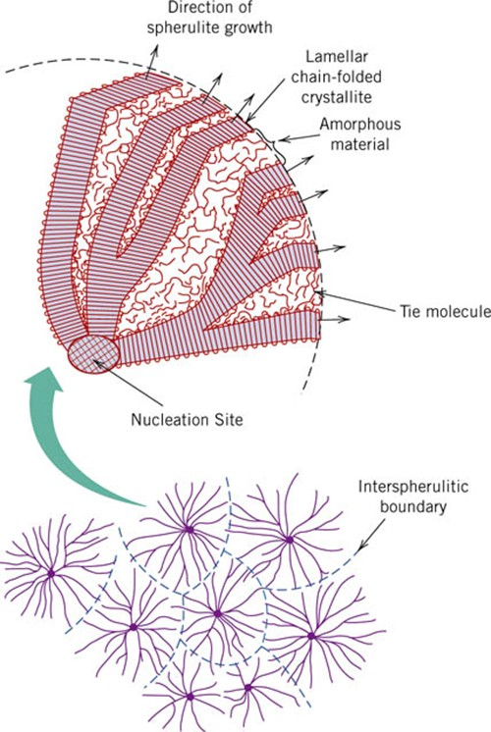
f14_13_pg513
Spherulite sructure
Notes:
f14_13_pg513.jpg

Slide 31
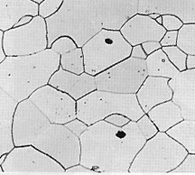

Single vs Polycrystals
• Single Crystals
E (diagonal) = 273 GPa
-Properties vary with
direction: anisotropic.
-Example: the modulus
of elasticity (E) in BCC iron:
E (edge) = 125 GPa
• Polycrystals
-Properties may/may not
vary with direction.
-If grains are randomly
oriented: isotropic.
(E_{poly iron} = 210 GPa)
-If grains are textured,
anisotropic.
200 μm

Slide 32
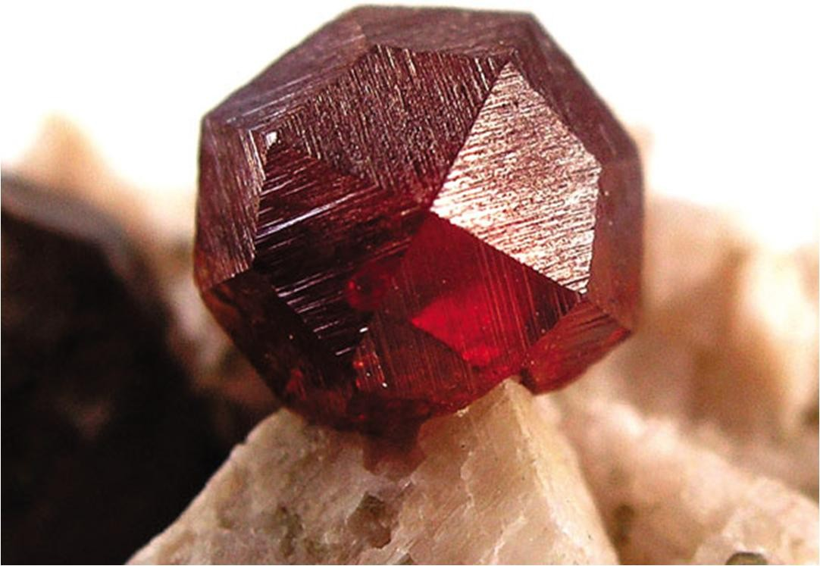
f16_03_pg64
Notes:
f16_03_pg64.jpg

Slide 33
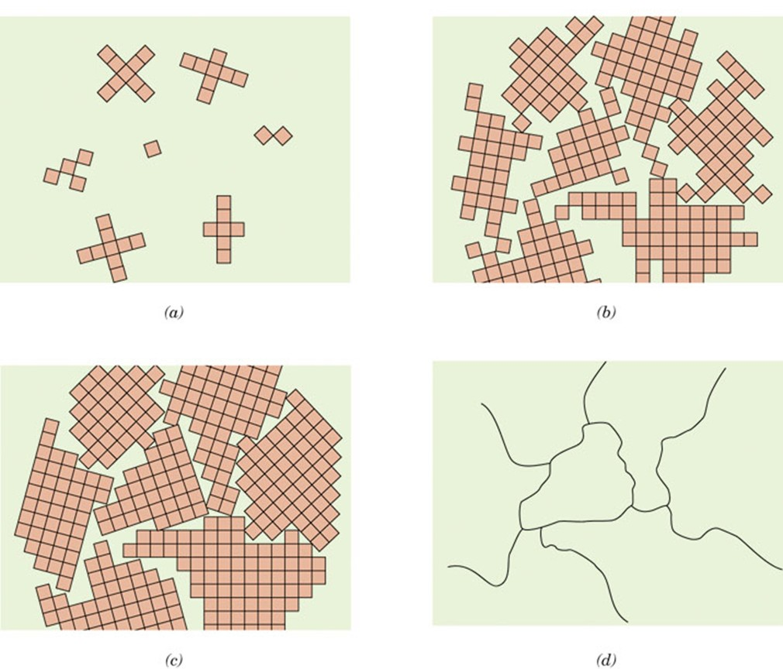
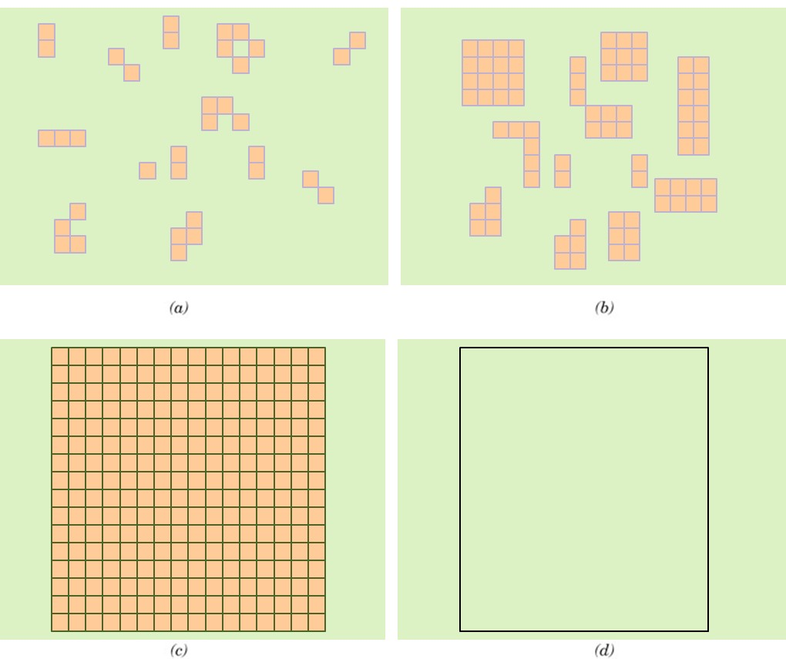
f17_03_pg65
Concept of Grains and Grain Boundary: Single crystal vs. polycrystalline
Notes:
f17_03_pg65.jpg

